Slide 1
The Rady School of Management
MGT 103
Lecture #16
Personal Selling
Putting it all Together
March 9, 2020

Slide 2

MEET TODAY’S SALES PROFESSIONAL CUSTOMER RELATIONSHIP PHILOSOPHY
Commit to Creating Value for Clients.
Seek to Serve Clients as a Trusted Consultant.
Reinforce the Company’s Competitive Advantage.
Regard Challenges as Opportunities.
©Hillsman Stuart Jackson

Slide 3

SCOPE AND SIGNIFICANCE OF PERSONAL SELLING AND SALES MANAGEMENT
Personal Selling
Sales Management
Selling Happens Almost Everywhere
“Everyone Lives by Selling Something”
20% of CEOs Have
Sales Experience
©Radius Images/Getty Images

Slide 4

PERSONAL SELLING IN MARKETING AND ENTREPRENEURSHIP
Personal Selling Roles:
Salespeople Are Critical Link Between Firm and Customers
Salespeople ARE the Company in a Consumer’s Eyes
Personal Selling May Play a Dominant Role in Firm’s Marketing
Selling Business Concept to Investors
Cambridge Sales

Slide 5
SCOPE AND SIGNIFICANCE OF PERSONAL SELLING AND SALES MANAGEMENT CREATING CUSTOMER SOLUTIONS AND VALUE (1 of 2)
Salespeople:
Identify Creative Solutions to Customer Problems
Ease the Customer Buying Process
Make the After-the-Sale Follow-Up

Slide 6

MARKETING MATTERS Science and Selling: Is Customer Value Creation in Your Genes?
Genetic Markers Indicate Predisposition or Willingness to Interact with Customers.
Sales Orientation: Sell as Much as Possible.
Customer Orientation: Align Problems with Solutions for Customers.
©Dimitri Otis/Photographer's Choice/Getty Images

Slide 7
THE MANY FORMS OF PERSONAL SELLING ORDER TAKING
Order-Taker “Farmer”
Visit Customers and Replenish Inventory
Outside Order Takers
Inside Order Takers
Order Clerks
Sales Clerks
Inbound Telemarketing
Represent Products with Few Options

Slide 8
THE MANY FORMS OF PERSONAL SELLING ORDER GETTING
Order Getter “Hunter”
Identify Prospective Customers
Provide Customers with Information
Persuades Customers to Buy
Closes Sales
Follow-up on Customer’s Use of Product
Outside Order Getters
Inside Order Getters

Slide 9
THE MANY FORMS OF PERSONAL SELLING CUSTOMER SALES SUPPORT PERSONNEL
Missionary Salespeople
Introduce New Products
Sales Engineer
Identify, Analyze, Solve Problems
Team Selling
Professionals Who Sell and Service
Conference Selling
Meet to Discuss Opportunities
Seminar Selling
Educational Programs

Slide 10

MARKETING MATTERS Creating and Sustaining Customer Value through Cross-Functional Team Selling
75% of Companies Employ Cross-Functional Teams
Work with Customers to Create Value
Examples:
Xerox, IBM, DuPont, P&G
©blickwinkel/Alamy Stock Photo

Slide 11

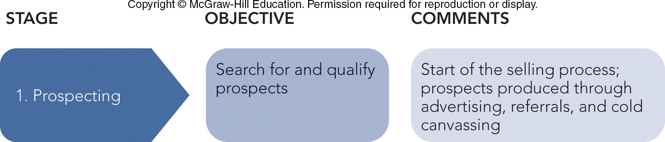
THE PERSONAL SELLING PROCESS: BUILDING RELATIONSHIPS PROSPECTING
Personal Selling Process
Prospecting Stage: Identify and Qualify Prospects
Types of Prospects
Lead
Prospect
Qualified Prospect
Cold Canvassing/Cold Calling
©Urbanmyth/Alamy Stock Photo

Slide 12
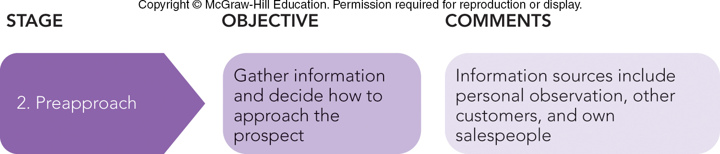
THE PERSONAL SELLING PROCESS: BUILDING RELATIONSHIPS PREAPPROACH
Preapproach Stage: Preparing for the Sales Call
Method
Expectations- Set an objective!
When to Contact

Slide 13

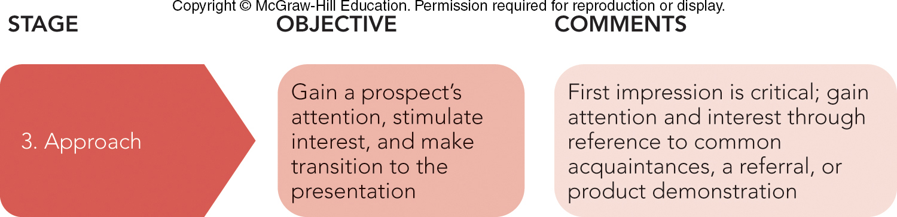
THE PERSONAL SELLING PROCESS: BUILDING RELATIONSHIPS APPROACH
Approach Stage: Making the First Impression
Establish Rapport
Customs
Gestures
©Phillip Jarrell/Taxi/Getty Images

Slide 14
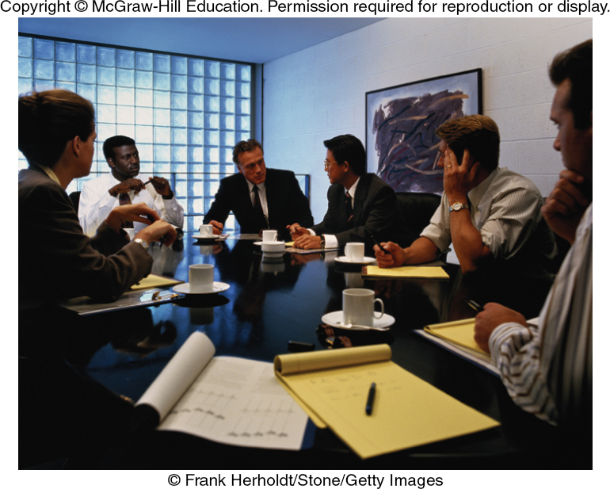
MARKETING MATTERS Imagine This…Putting the Customer into Customer Solutions!
Companies Want Solutions to Problems:
Meet Requirements
Designed to Uniquely Solve Problem
Can Be Implemented
Ensures Follow-up
©Frank Herholdt/Stone/Getty Images

Slide 15

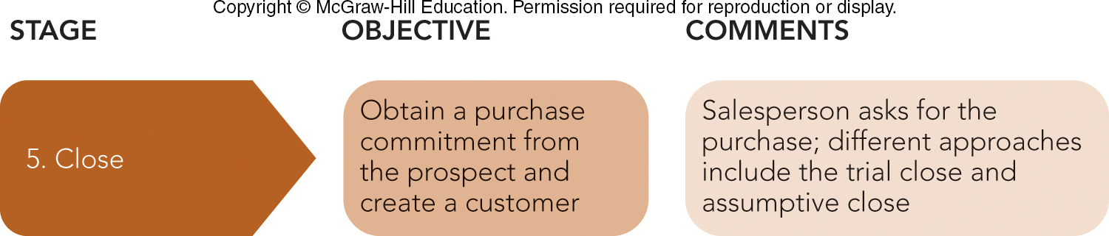
THE PERSONAL SELLING PROCESS: BUILDING RELATIONSHIPS CLOSE
Close Stage: Asking for the Order
Trial Close
Assumptive Close
Urgency Close
©Purestock/Getty Images

Slide 16
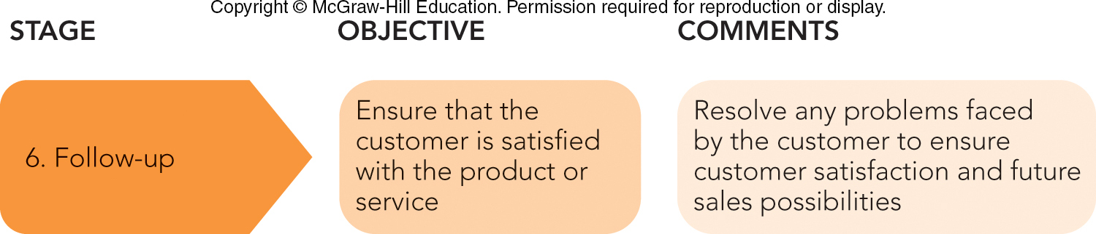
THE PERSONAL SELLING PROCESS: BUILDING RELATIONSHIPS FOLLOW-UP
Follow-Up Stage: Solidifying the Relationship
Repeat Sales
Referrals

Slide 17
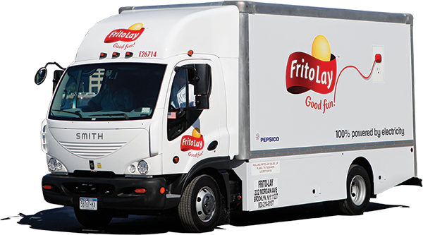
THE SALES MANAGEMENT PROCESS SALES PLAN FORMULATION (2 of 2)
Organizing the Salesforce
Geography – Uses Regions
Customer – Used for Different Markets
Product – Specific Expertise Needed
Use Company’s Own Salesforce, or Independent Agents?
©David Goldman/AP Images for Frito-Lay

Slide 18

MARKETING INSIGHTS ABOUT ME What Is Your Emotional Intelligence? You Might Be Surprised.
Emotional Intelligence
Self-Motivation Skills
Self-Awareness
Managing One’s Emotions
Empathy
Social Skills
Emotional Intelligence
Quiz
Courtesy of DTS International

Slide 19
The Rady School of Management
MGT 103 Lecture #17
“Putting it all together”

Slide 20



MARKETING BASICS: DOING WHAT WORKS AND ALLOCATING RESOURCES FINDING AND USING WHAT REALLY WORKS
Strategy: Clearly Stated, Focused
Execution: Flawless Execution
Culture: Performance-Oriented
Structure: Fast, Flexible, Flat
Skunk Works
©incamerastock/Alamy; ©Peter Probst/Alamy

Slide 21
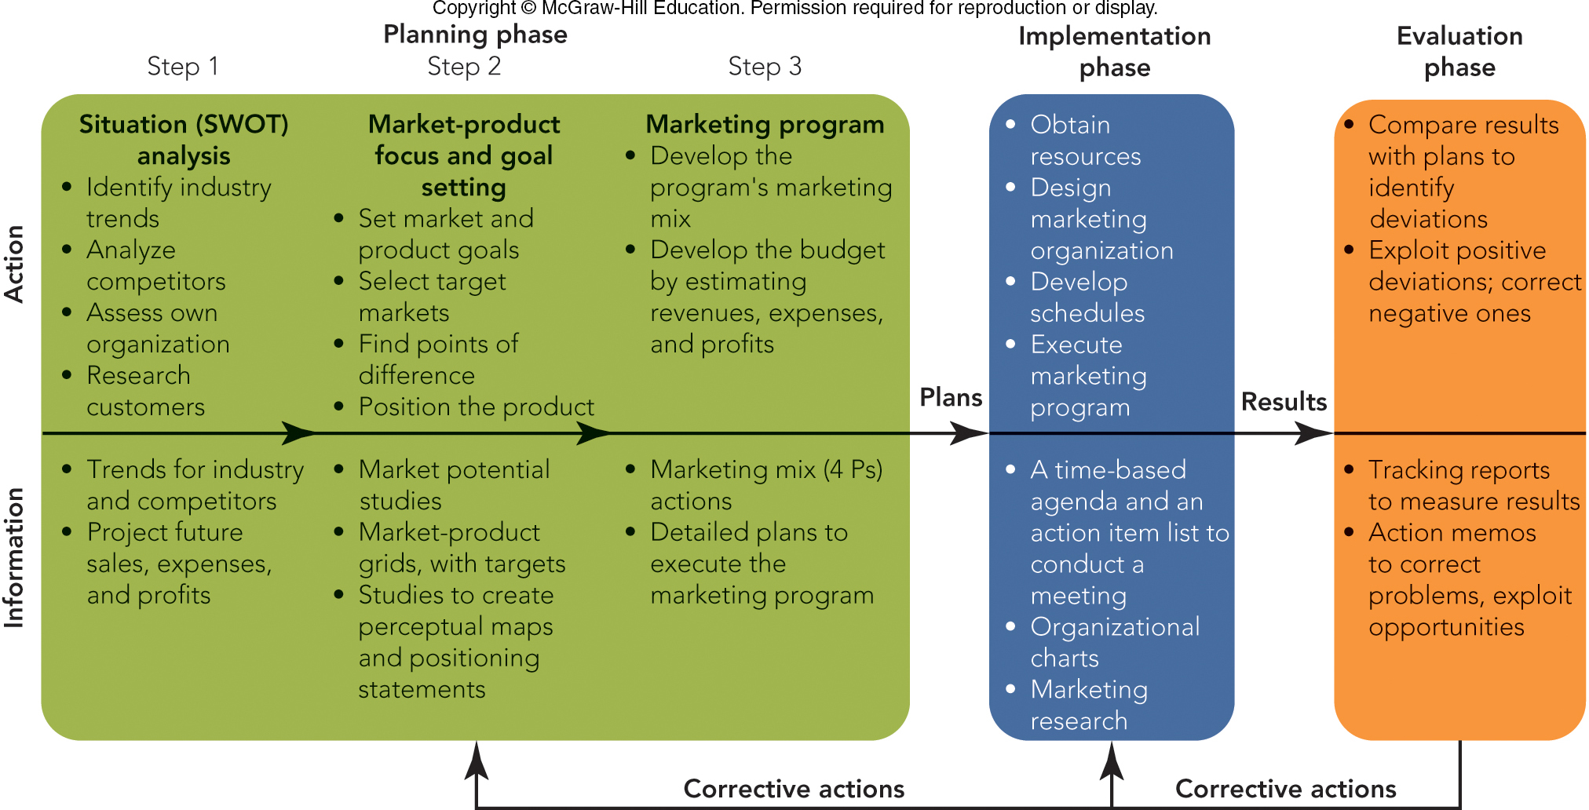
FIGURE 22-2 The actions in the strategic marketing process are supported and directed by detailed reports, studies, and memos

Slide 22
MARKETING BASICS: DOING WHAT WORKS AND ALLOCATING RESOURCES USING SALES RESPONSE FUNCTIONS (2 of 2)
Output Reports Examples
Phase | Output Report
Planning | Marketing plans (or programs) that define goals (with pertinent marketing metrics) and the marketing mix strategies to achieve them.
Implementation | Action memos that tell (1) who is (2) to do what (3) by when.
Evaluation | Corrective action memos, triggered by comparing results with goals, often using the firm’s marketing metrics and displayed in marketing dashboards.

Slide 23
THE PLANNING PHASE OF THE STRATEGIC MARKETING PROCESS USE OF METRICS IN MARKETING PLANNING
Importance of Metrics in Planning
Variety of Marketing Plans
Marketing Planning Frameworks
Key Planning and Strategy Lessons
Output Metrics: Measure Results
Input Metrics: Measure Efforts

Slide 24

THE PLANNING PHASE OF THE STRATEGIC MARKETING PROCESS THE VARIETY OF MARKETING PLANS
Long-Range Marketing Plans
Cover 2 – 5 Years
Annual Marketing Plans
Goals and Strategies for a Single Year
©McGraw-Hill Education

Slide 25
THE PLANNING PHASE OF THE STRATEGIC MARKETING PROCESS MARKETING PLANNING AND STRATEGY LESSONS (1 of 4)
Guidelines for an Effective Marketing Plan:
Set Measurable, Achievable Goals
Use a Base of Facts and Assumptions
Use Simple, but Clear and Specific Plans
Have Complete and Feasible Plans
Make Plans Controllable and Flexible
Find the Right Person to Implement
Work Toward Consensus-Building

Slide 26
THE PLANNING PHASE OF THE STRATEGIC MARKETING PROCESS MARKETING PLANNING AND STRATEGY LESSONS (2 of 2)
Marketing Planning & Strategy Problems
Plans Based on Poor Assumptions
Planners Lost Sight of Customer Needs
Too Much Time and Effort on Collecting Data and Writing Plans
Line Operating Managers Have No Ownership in Implementing Plans
Papa John’s

Slide 27
THE IMPLEMENTATION PHASE OF THE STRATEGIC MARKETING PROCESS EMPHASIS ON MARKETING IMPLEMENTATION
Move Some Planning Activities From Planners to Line Managers
Build Trust and Autonomy among Managers and Employees
Make the Planners Responsible for Carrying Out the Plans

Slide 28

THE IMPLEMENTATION PHASE OF THE STRATEGIC MARKETING PROCESS IMPROVING MARKETING PROGRAM IMPLEMENTATION (1 of 4)
Take Action and Avoid Paralysis by Analysis
“Bias for Action” 80% rule
“Do It, Fix It, Try It” Approach
F-35 Lightning II

Slide 29
THE IMPLEMENTATION PHASE OF THE STRATEGIC MARKETING PROCESS IMPROVING MARKETING PROGRAM IMPLEMENTATION (2 of 4)
Surface Problems with Open Communication
When Trouble Develops:
Surface Problems Immediately
Get Help—Don’t Keep Problems to Yourself, Seek Solutions from Anyone

Slide 30
THE IMPLEMENTATION PHASE OF THE STRATEGIC MARKETING PROCESS IMPROVING MARKETING PROGRAM IMPLEMENTATION (3 of 4)
Communicate Goals and the Means to Achieve Them
Toyota Stresses Genchi Genbutsu (“go and see”)
Have a Responsible Program Champion Willing to Act
Program Champion

Slide 31
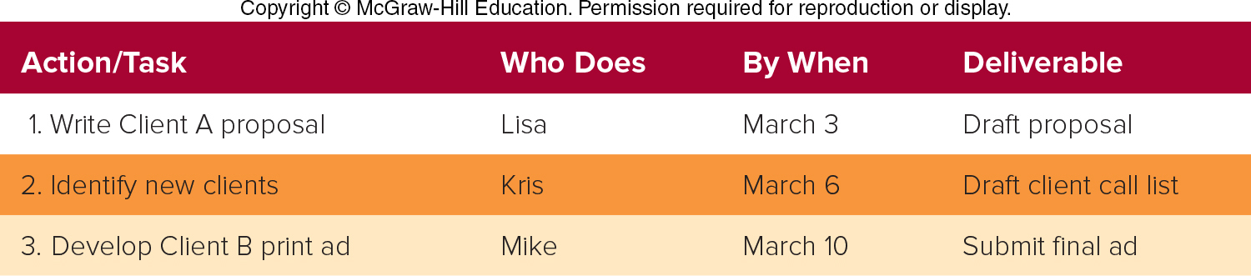
THE IMPLEMENTATION PHASE OF THE STRATEGIC MARKETING PROCESS IMPROVING MARKETING PROGRAM IMPLEMENTATION (4 of 4)
Schedule Precise Tasks, Responsibilities, and Deadlines
Action Item List
Program Schedules
Gantt Chart

Slide 32
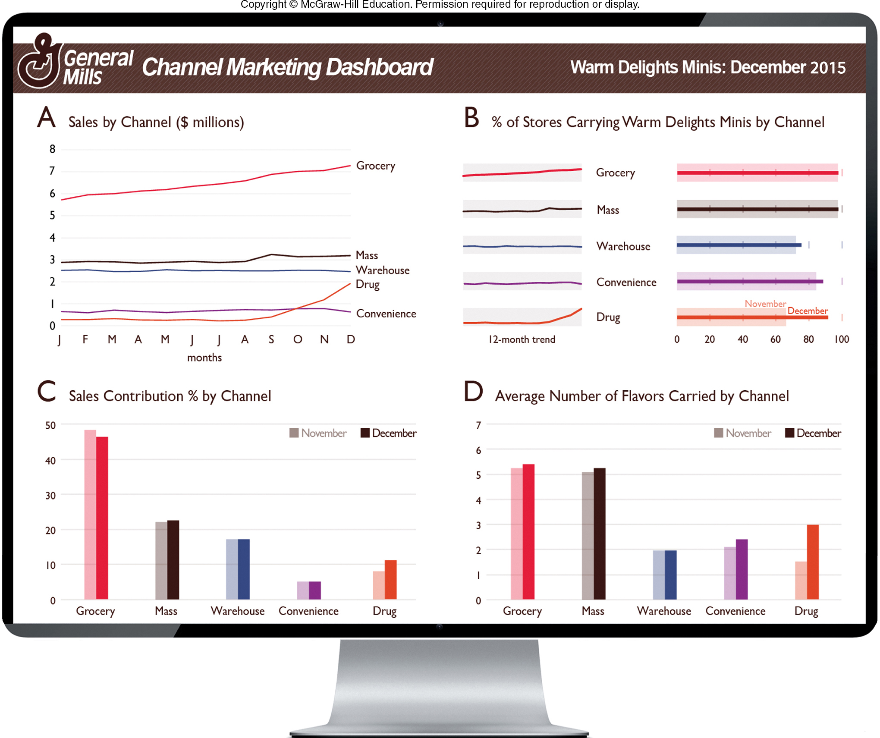
FIGURE 22-8 The marketing dashboard for the distribution channels for General Mills’ Warm Delights Minis

Slide 33
FIGURE 22-2 The actions in the strategic marketing process are supported and directed by detailed reports, studies, and memos

Slide 34
Announcements……Last Day of Class on Wednesday
5-minute presentation of your Group Business Plan on Wednesday in class (maximum five slides, rehearse timing!)
Dress for Success!!!
Please send presentation slides to Alli by no later than 5:00 p.m. on Tuesday
Group Leaders-
Submit entire Final PowerPoint deck (12-15 slides) via Canvas – Due 11:00 a.m. Wednesday, March 11
Submit Executive Summary “one pager” by no later than 11:30 a.m. on Monday, March 16th. Email to Professor De Mill
Team Members –
submit your 2-3 page ds Business Plan Section Brief of your section/sections (e.g. Competition, SWOT) via Canvas. ( don’t need to submit your slides) submitted by 11:00 a.m. Wednesday, March 11th
Quick Final Exam Review in class on Wednesday!

Slide 35
The Rady School of Management
MGT 103
Lecture #16
Personal Selling
Putting it all Together
March 9, 2020

